Slide 1



Cybersecurity as a market condition for European SMEs.
Webinar, 25th of February 2026
Ovidiu Mihăilă, Bitdefender

Slide 2
Content.
Cybersecurity in 2026.
The threat reality.
The SME vulnerability.
Business impact.
Actionable priorities.
Implementation roadmap.
Take-aways.

Slide 3
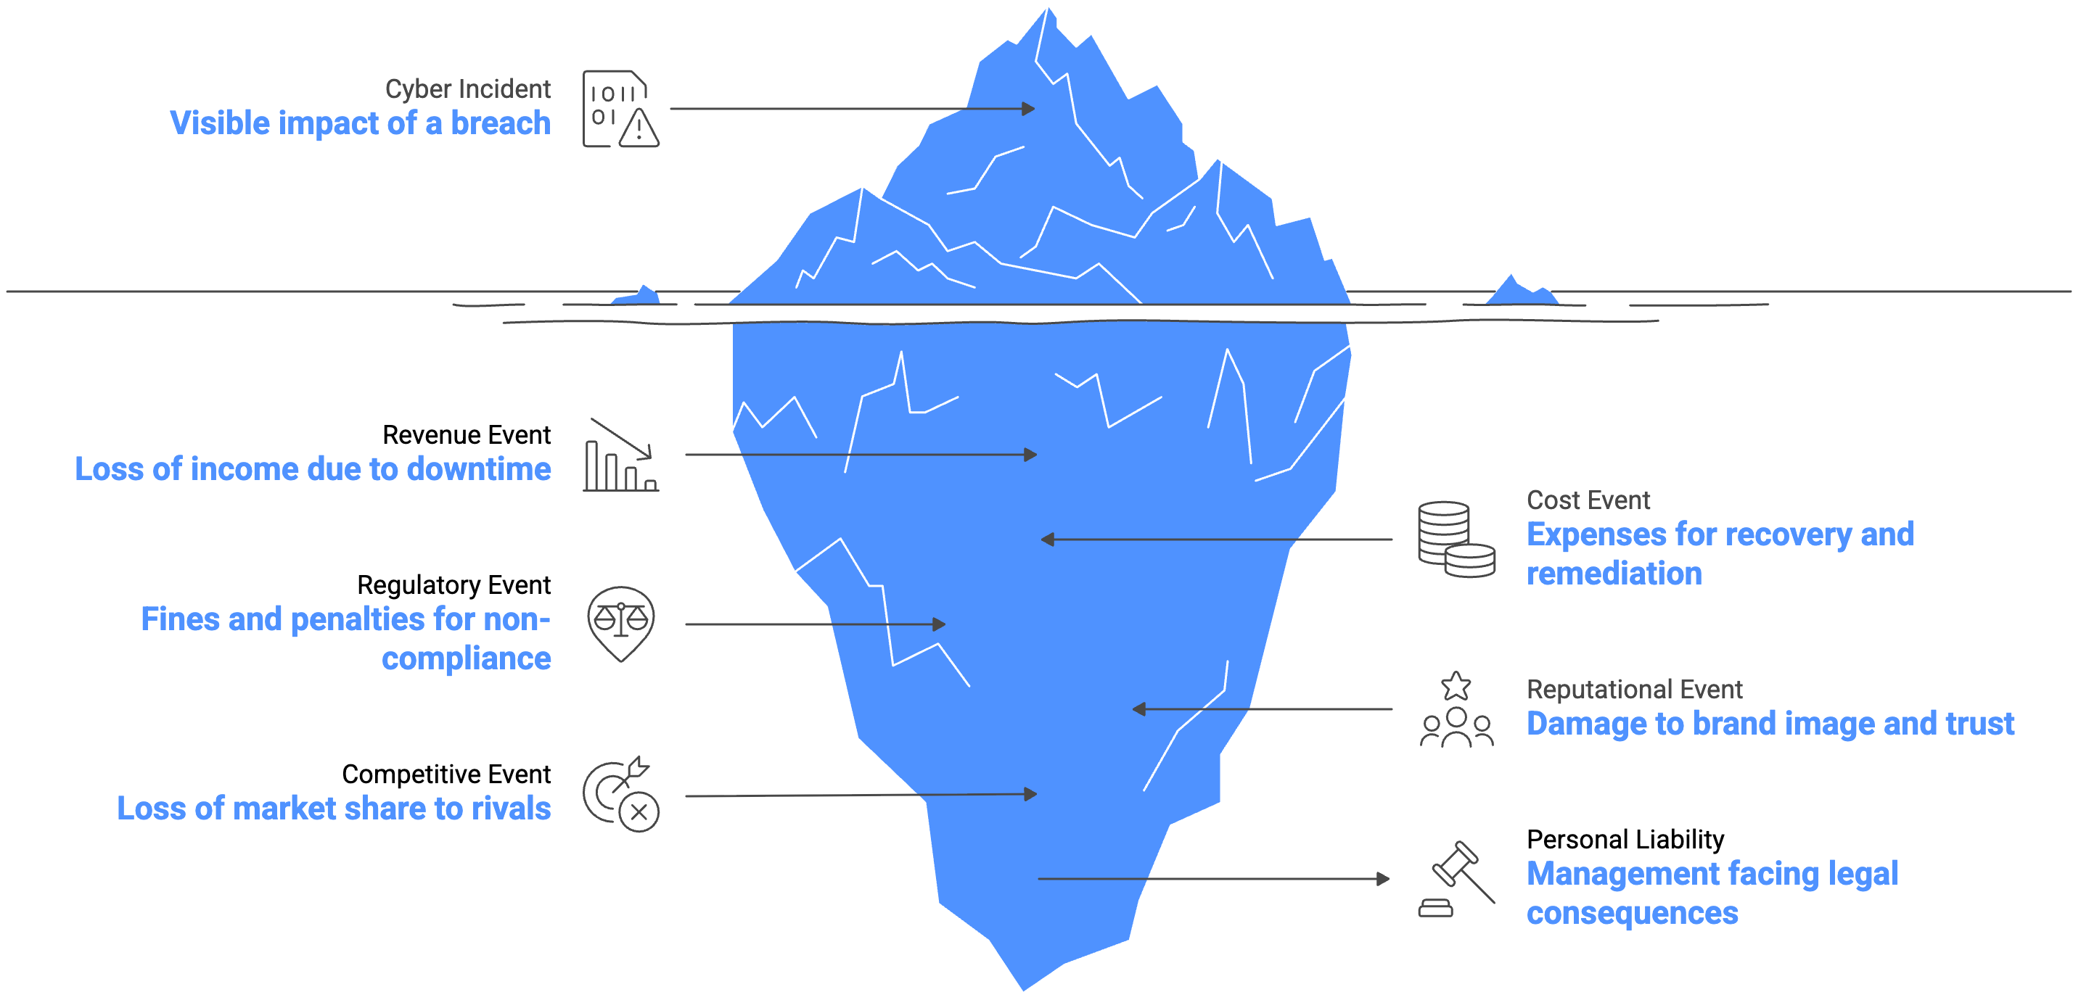
1. Cybersecurity in 2026.
Cyber risk is a business competitiveness problem and not an IT task.

Slide 4
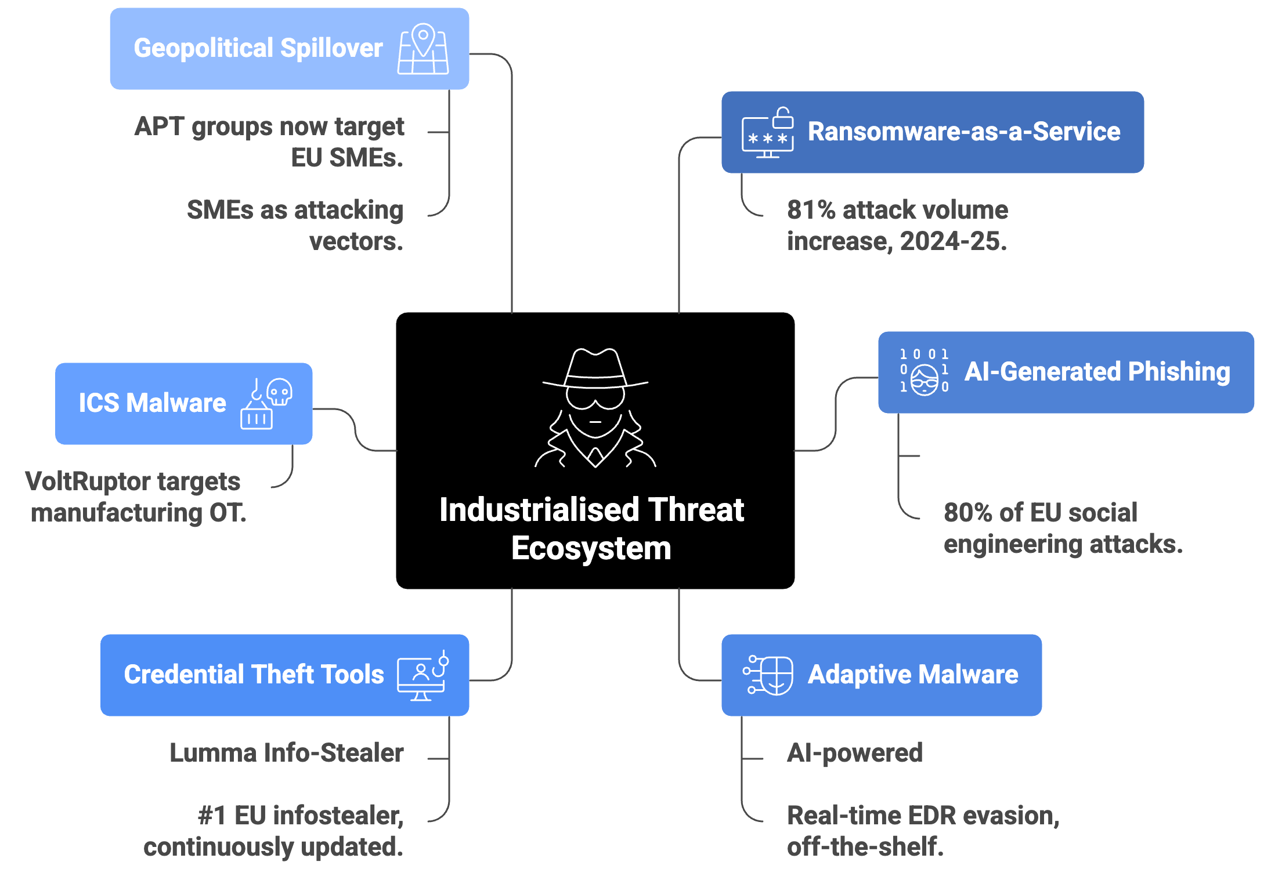
2. The threat reality.
An industrialised criminal ecosystem that has democratised sophisticated attack capability. Attack volume targeting EU SMEs grew 81% in 2024-25.

Slide 5
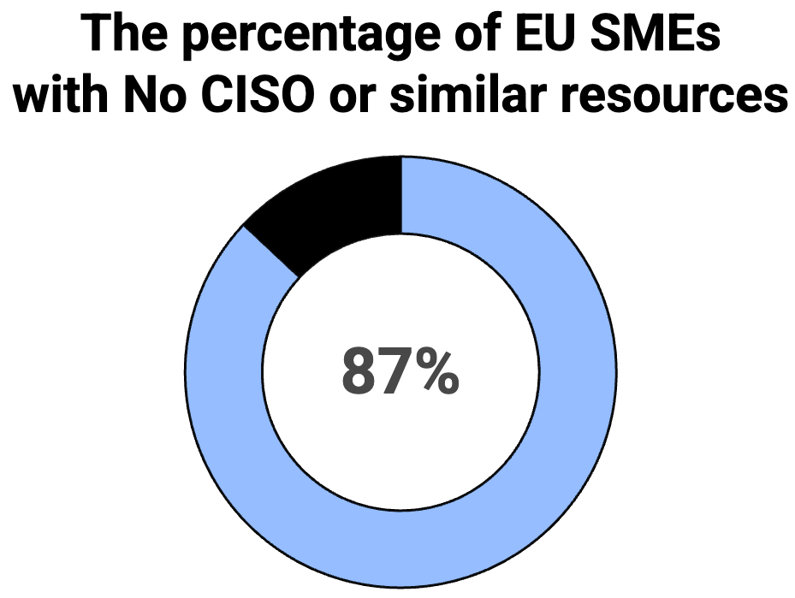
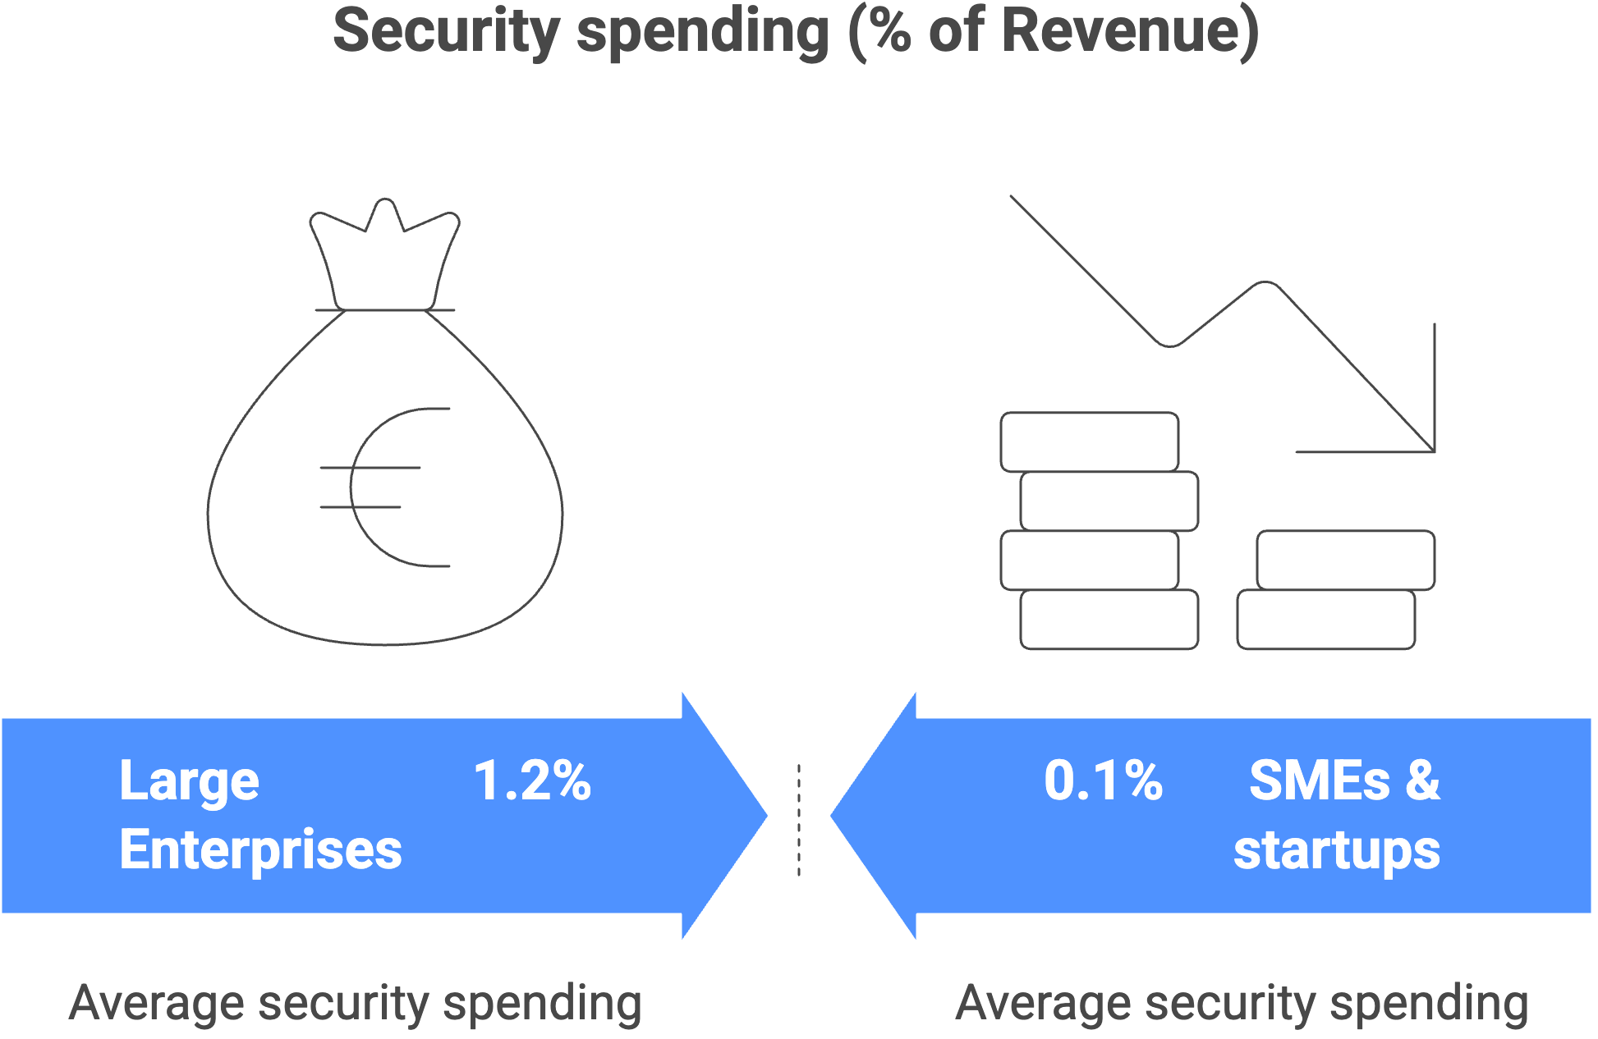
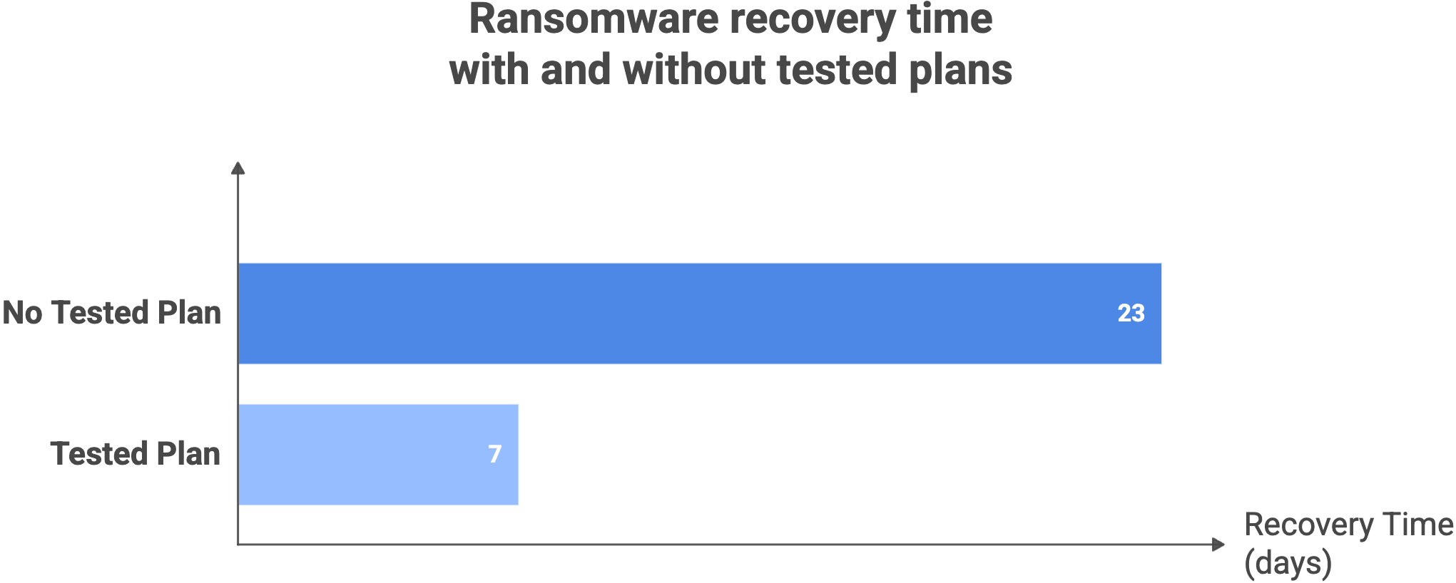
3. The SME vulnerability. (I)
For the European SMEs, size is no longer a shield.

Slide 6
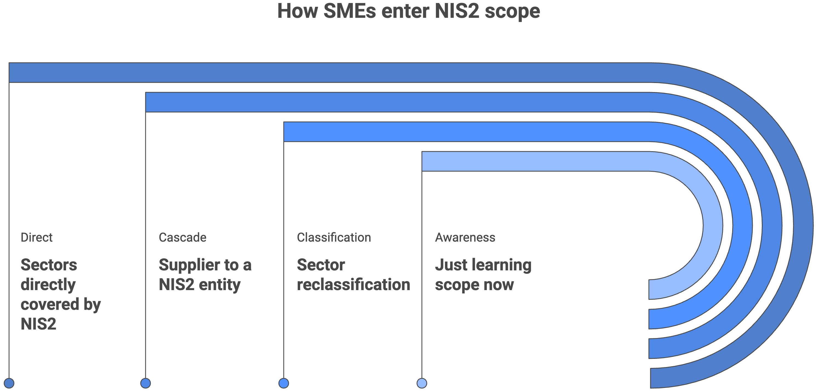
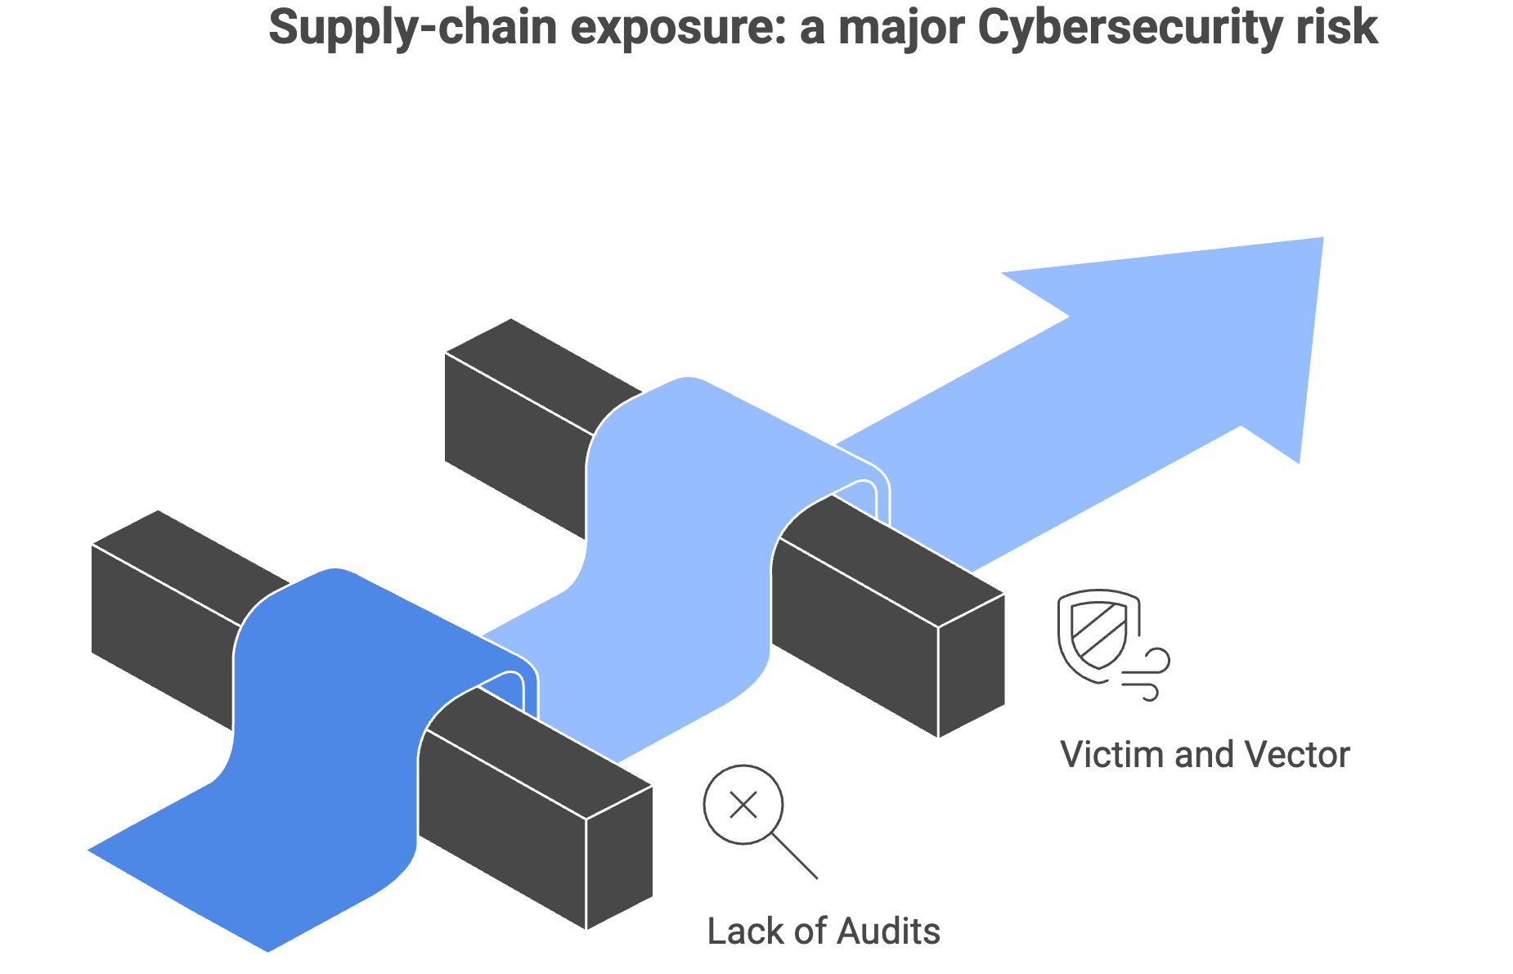
3. The SME vulnerability. (II)
For the European SMEs, size is no longer a shield.

Slide 7
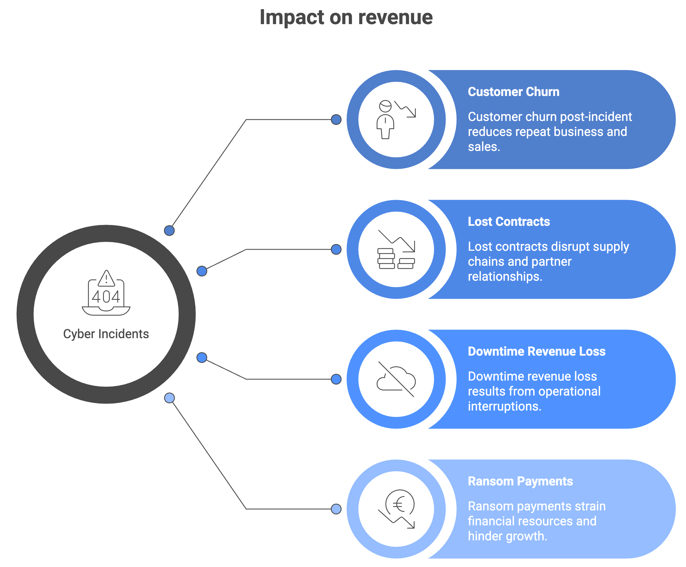
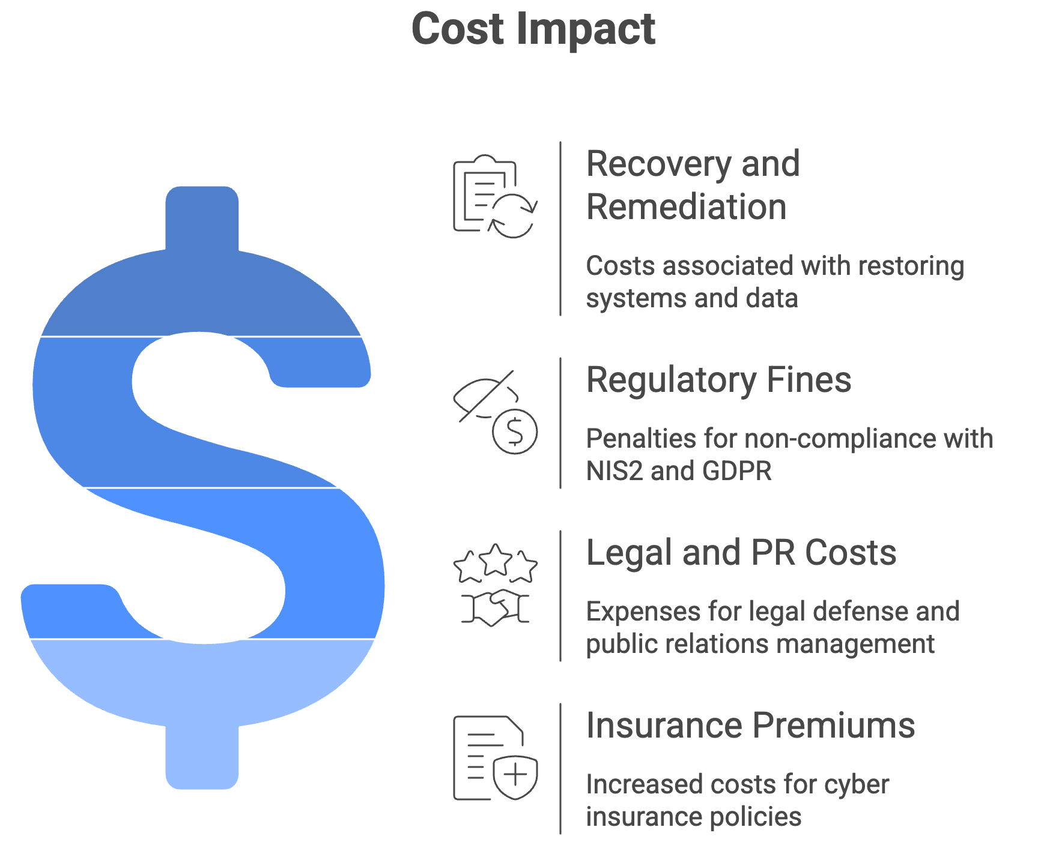
4. Business impact. (I)
How cyber risk flows through a SME’s P&L, balance sheet, and market position.

Slide 8
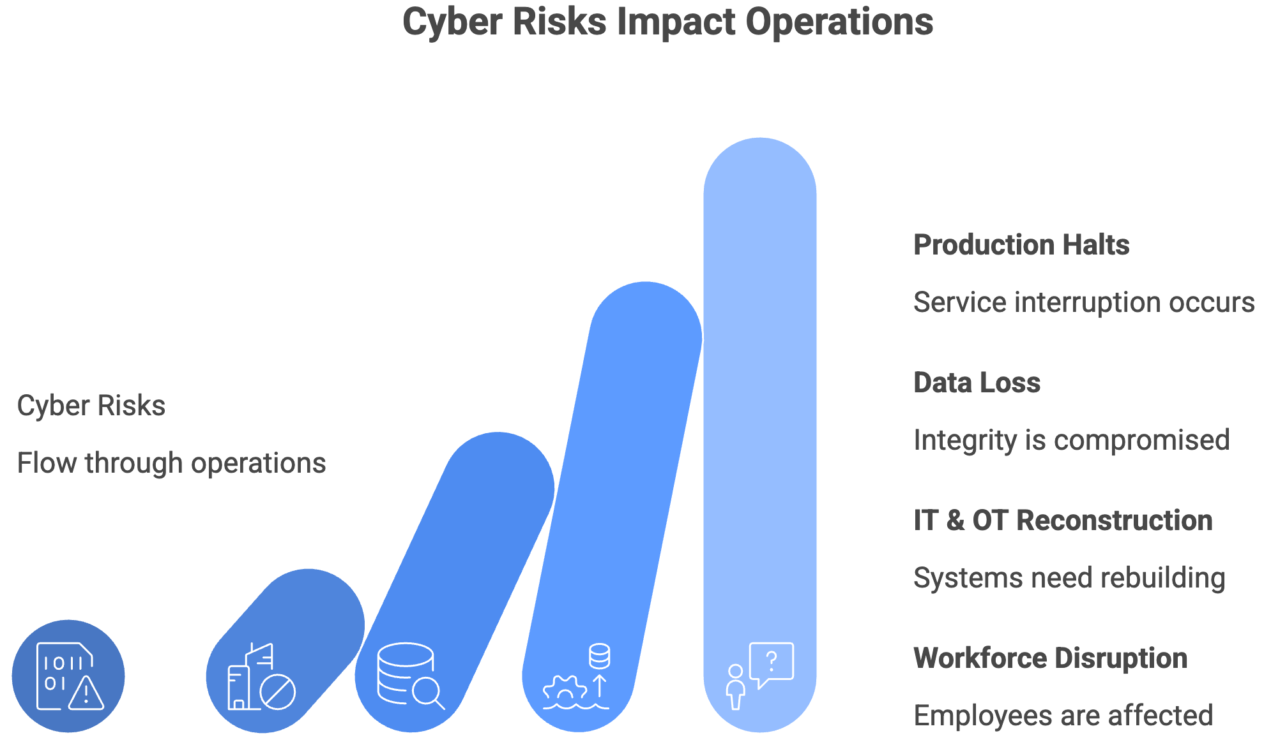
4. Business impact. (II)
How cyber risk flows through a SME’s P&L, balance sheet, and market position.

Slide 9
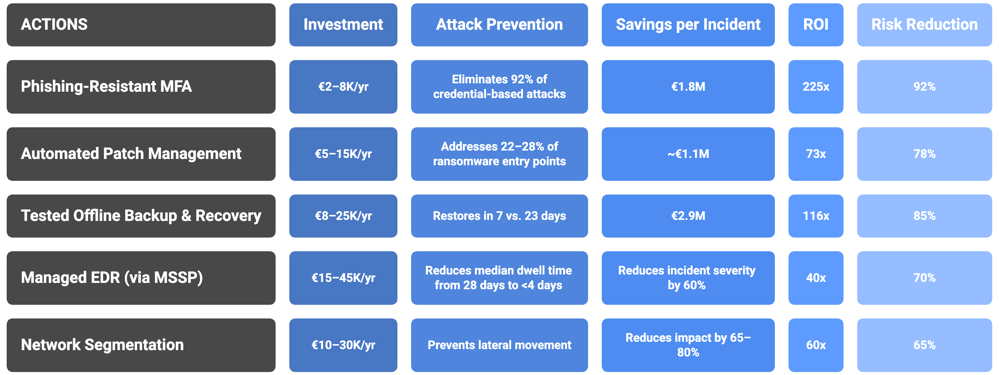
5. Actionable priorities. (I)

Slide 10
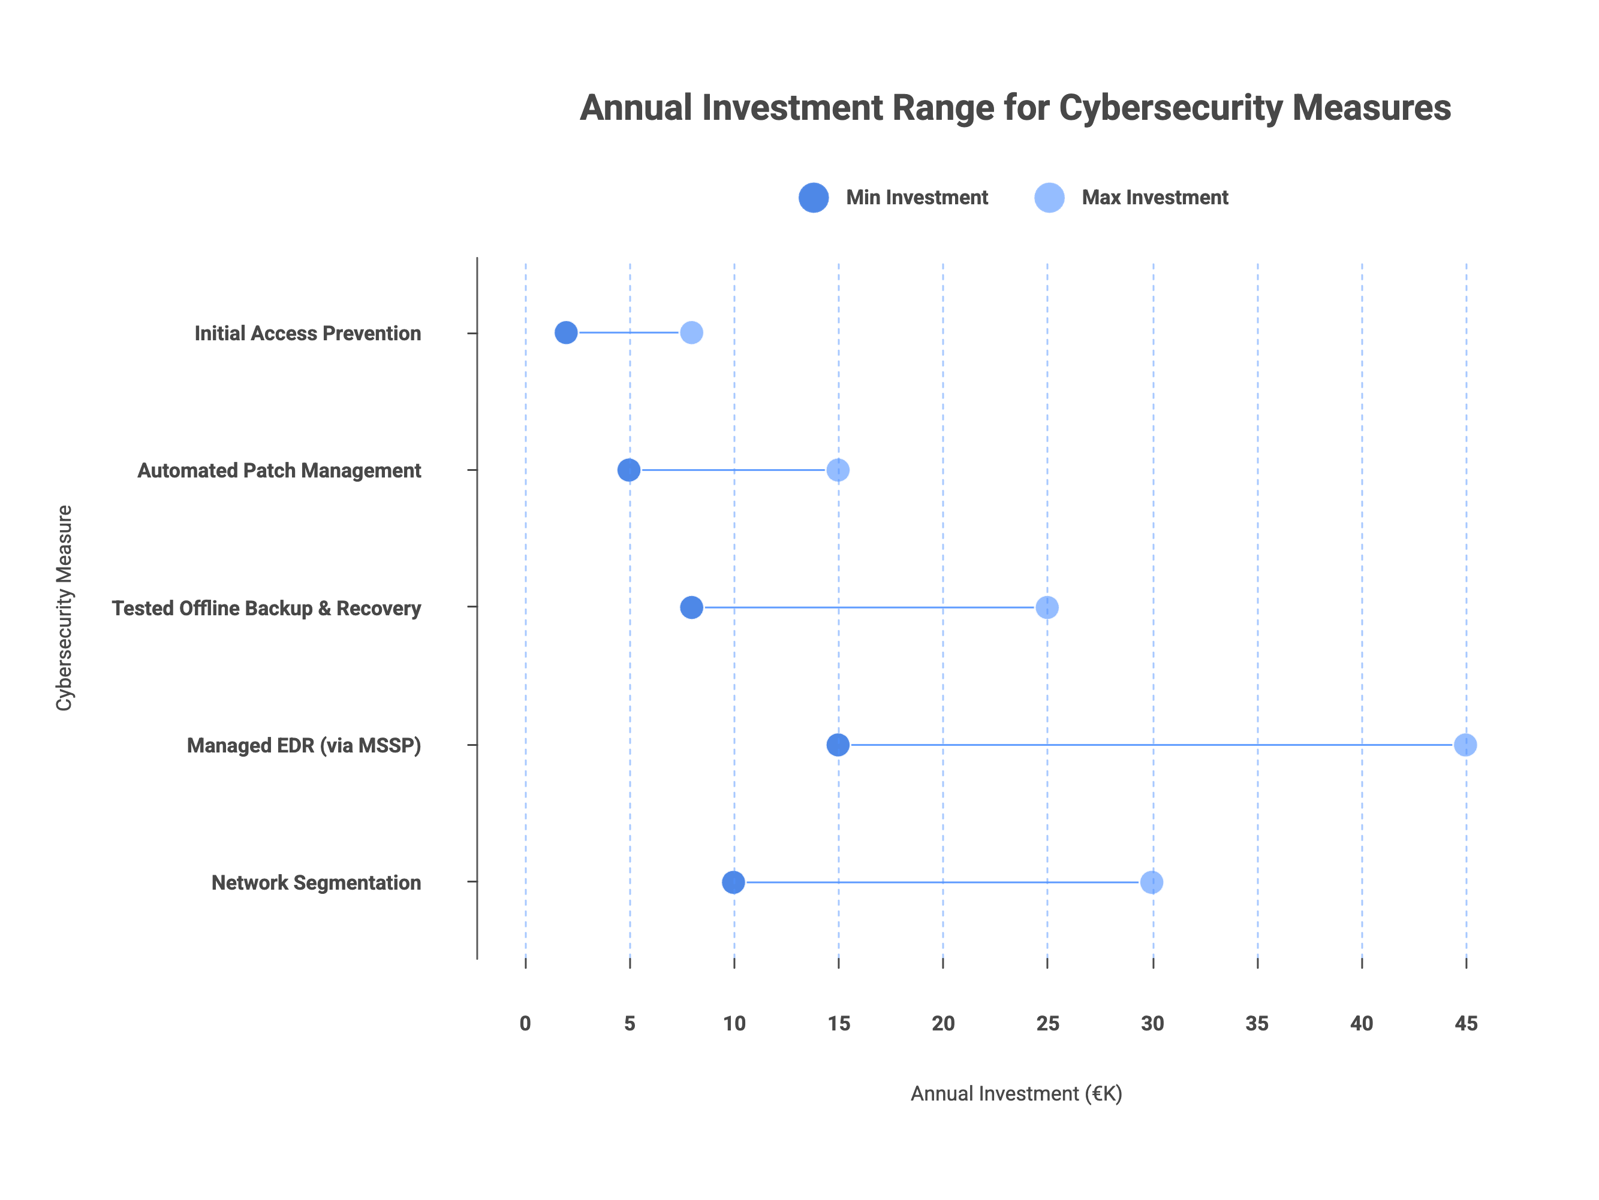
5. Actionable priorities. (II)

Slide 11
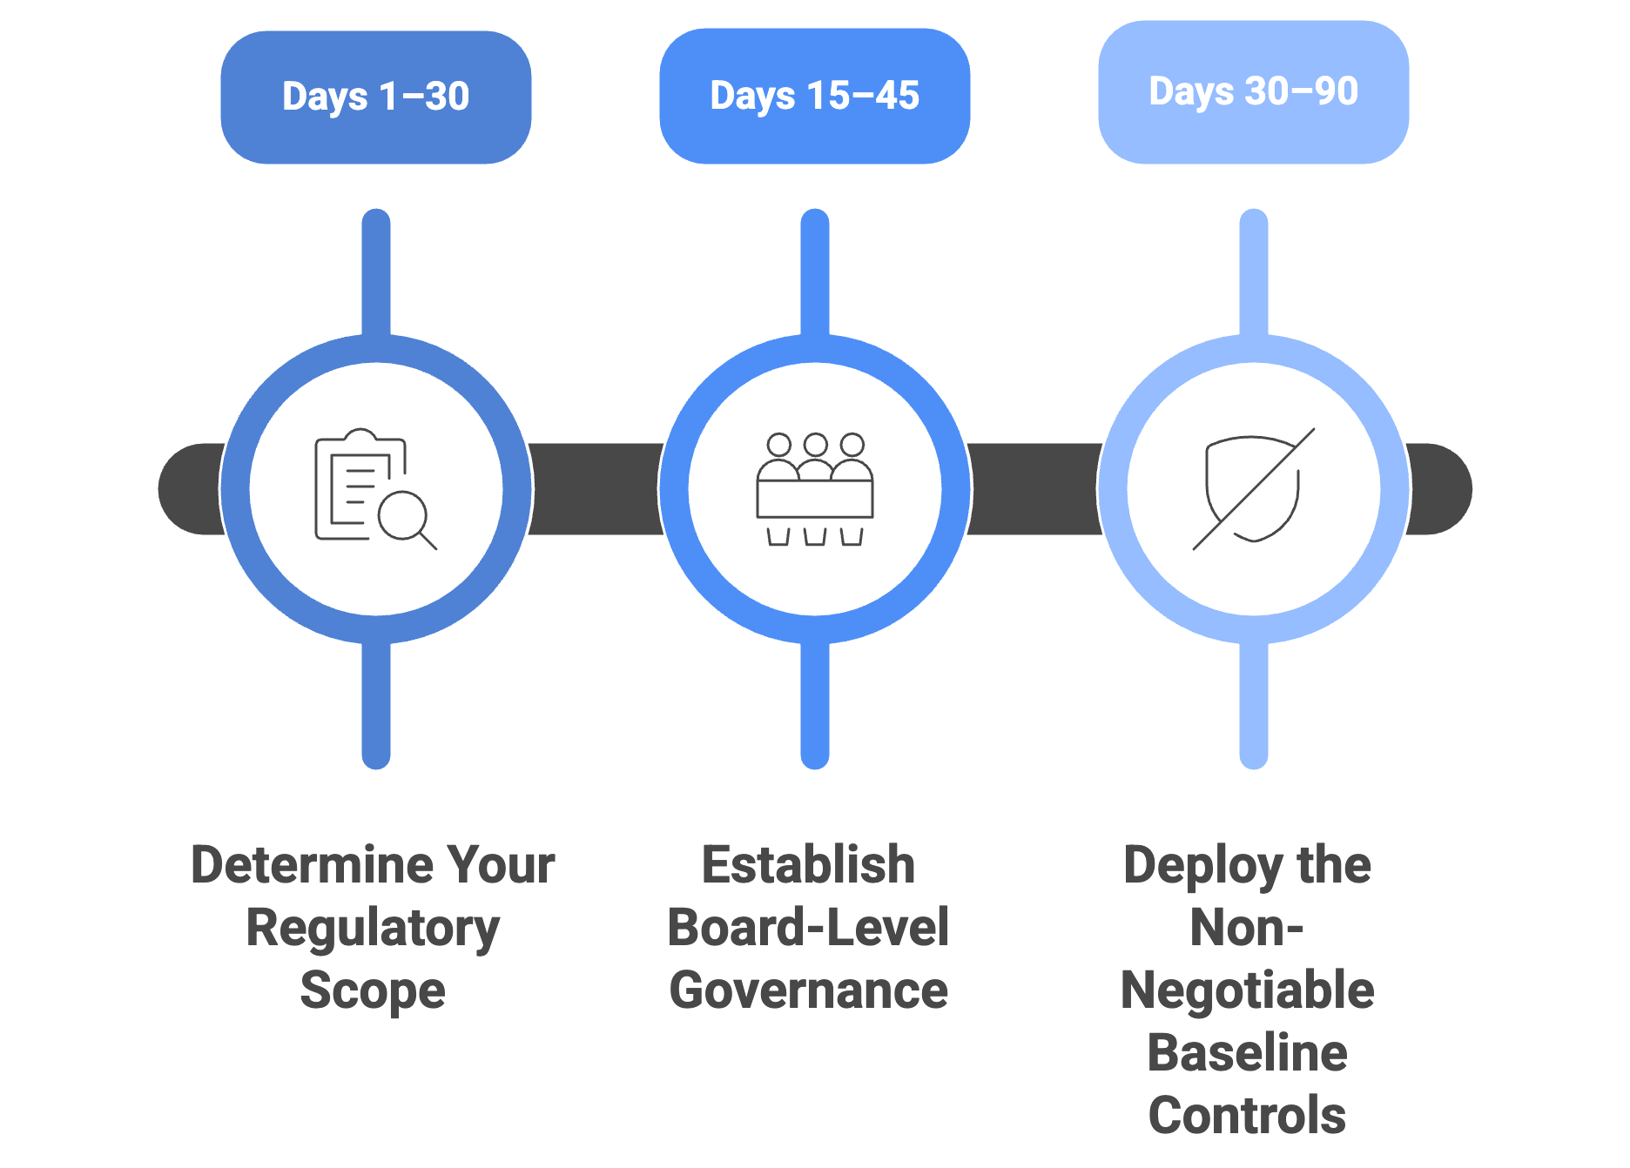
6. Implementation roadmap. (I)
The 90 days agenda.

Slide 12
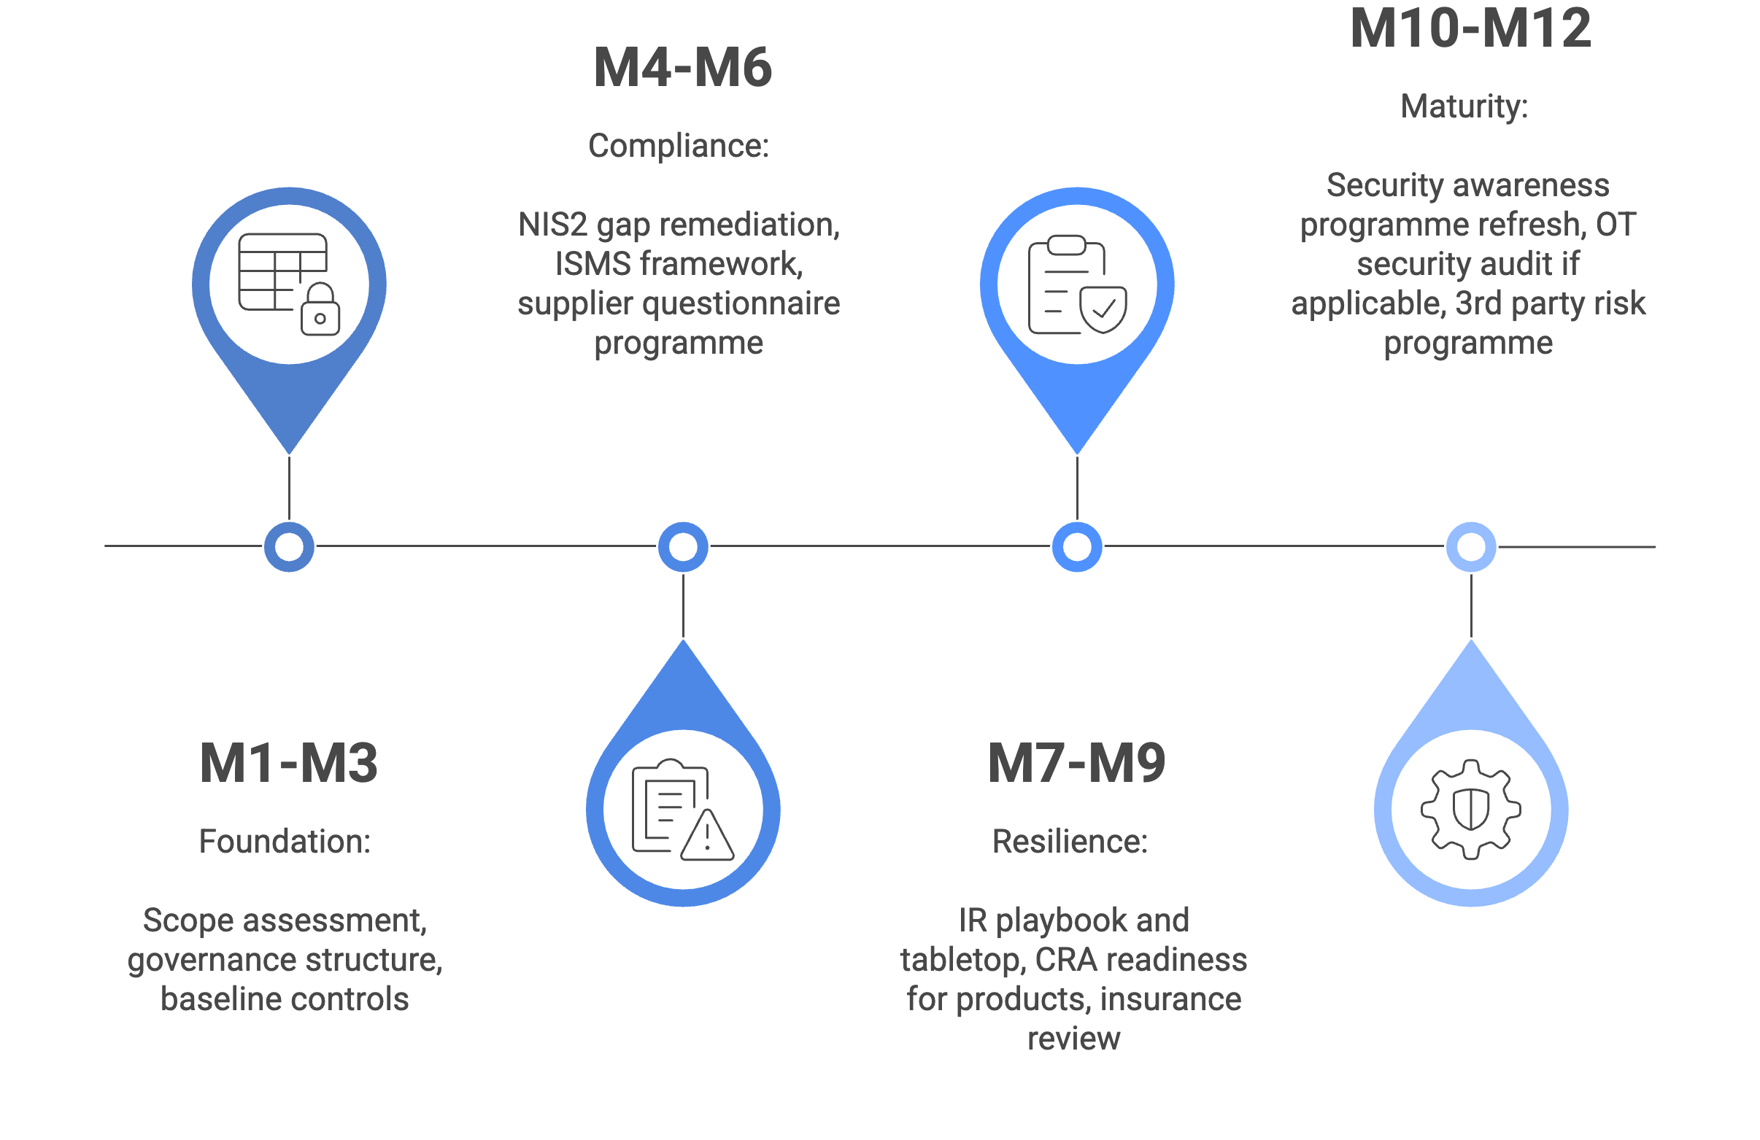
6. Implementation roadmap. (II)
The 1-year steps.

Slide 13
7. Some take-aways.
Cybersecurity is a competitive edge.
1. | Cyber risk is on your P&L, not just your IT risk register.
2. | NIS2 imposes personal liability on you, not your IT team.
3. | Supply-chain pressure will cost you contracts, not just comfort.
4. | The five baseline controls deliver a 40–225× return.
5. | Early movers win supply-chain positions. Late movers lose them.

