Slide 1








Smart and Practical Cybersecurity Solutions for SMEs in 5G+ Networks
Wissam Mallouli, PhD
Senior Researcher and CTO
Notes:
“I’ll share how we approach 5G cybersecurity from an SME perspective — not theory, but tools and operational experience.”

Slide 2

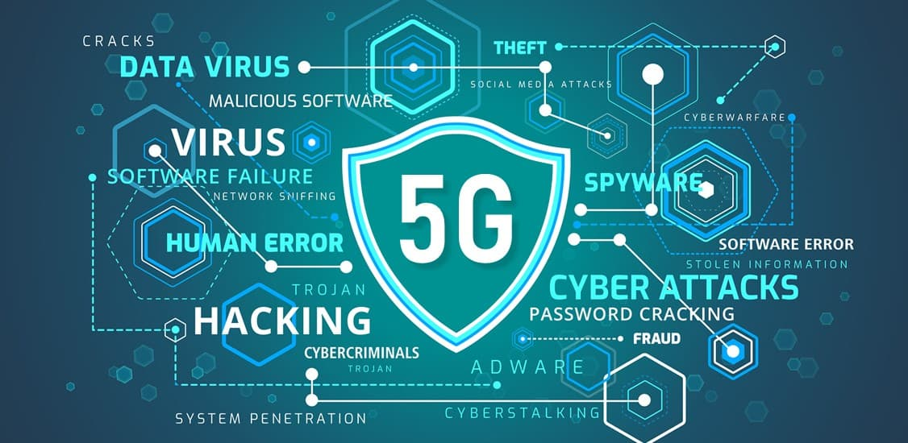
Why Cybersecurity Is a Business Issue for SMEs
SMEs in 5G+ Networks
In 5G+, cybersecurity directly impacts business viability
  5G increases connectivity, exposure, and dependencies
  Customers and partners now ask:
    How do you detect and manage cyber incidents?
    How do you ensure service continuity and trust?
  Cybersecurity affects:
    Market access
    Contractual trust
    Cross-border collaboration
  With NIS2, incident management and reporting are becoming mandatory, even for SMEs
5G Cybersecurity
A business issue
SME & 5G
Not a single role
Montimage Technologies for SMEs
Takeaways

Slide 3
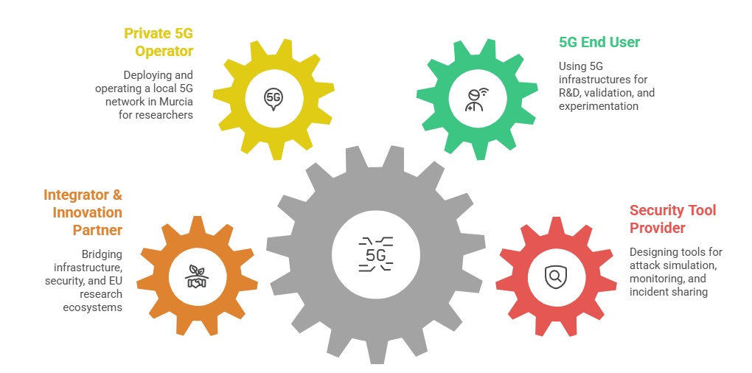
SMEs in 5G: Not a Single Role
SMEs in 5G+ Networks
SMEs play multiple roles in the 5G ecosystem
End users of 5G : Using public or private 5G for industry, research, or services
Technology & security tool providers : Delivering solutions that must be secure by design
Private / local 5G operators : Managing campus or local 5G networks with real operational responsibility
Integrators & innovation enablers: Connecting infrastructure, applications, and security across borders
Etc.
5G Cybersecurity
A business issue
SME & 5G
Not a single role
Montimage Technologies for SMEs
Takeaways

Slide 4
SMEs in 5G should do the right thing for their role
SMEs in 5G+ Networks
SME profile | What they must be accountable for
Private / local 5G operator | Network availability, security monitoring, incident reporting
5G service provider | Service continuity, customer impact, incident communication
5G technology / tool provider | Secure design, vulnerability handling, responsible disclosure
Integrator / project partner | Secure integration, visibility, coordination
5G Cybersecurity
A business issue
SME & 5G
Not a single role
Montimage Technologies for SMEs
Takeaways
SMEs must behave as accountable actors within their scope of responsibility in the 5G ecosystem.

Slide 5


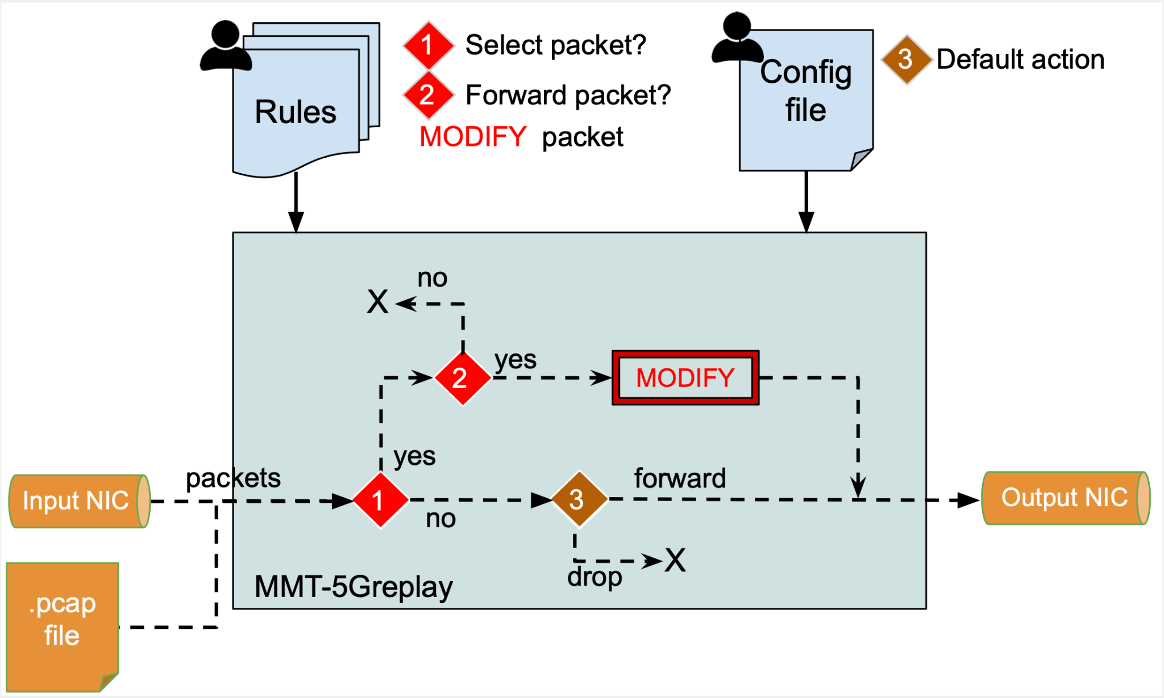
5Greplay: Attacking 5G to Build Credible Security
SMEs in 5G+ Networks
https://5greplay.org/
5G Cybersecurity
A business issue
Mutation operators
delete packets
duplicate packets
modify packet fields
SME & 5G
Not a single role
Montimage Technologies for SMEs
Takeaways
reorder packets
Delete/duplicate sessions
change bitrate
Purpose:
✔ Understand real risks
✔ Validate security mechanisms
✔ Demonstrate credibility to customers and partners

Slide 6

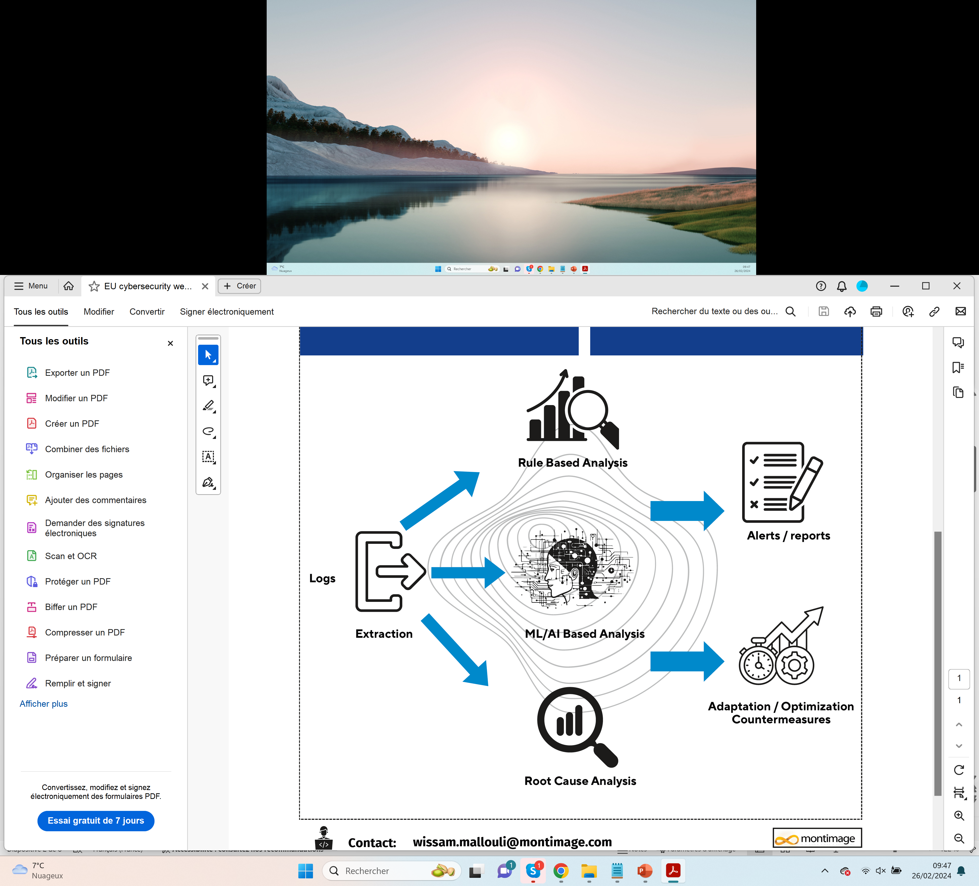
From Attacks to Detection: Why Monitoring Matters
SMEs in 5G+ Networks
Attacks without detection are useless
5G environments are:
  Distributed
  Virtualised
  Highly dynamic
Many attacks do not cause immediate failures
  SMEs typically face:
  No dedicated SOC
  Limited security staff
  Strong operational constraints
→ Detection must be automated, lightweight, and actionable
5G Cybersecurity
A business issue
MMT-5G : Montimage Monitoring Tool
SME & 5G
Not a single role
Montimage Technologies for SMEs
Takeaways
http://github.com/montimage/mmt-probe

Slide 7
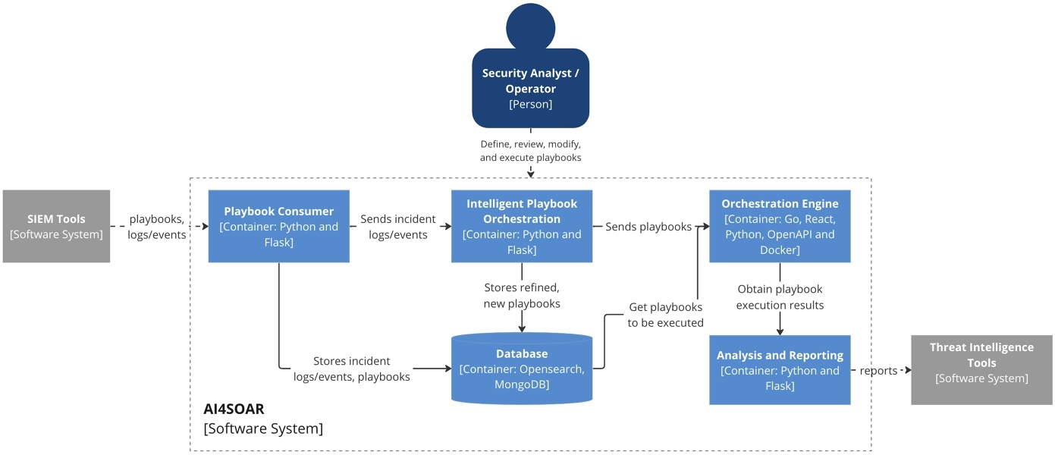
AI-Assisted Security Orchestration for SMEs
SMEs in 5G+ Networks
http://github.com/montimage/AI4SOAR
5G Cybersecurity
A business issue
SME & 5G
Not a single role
Montimage Technologies for SMEs
Takeaways
  AI4SOAR assists in:
    Correlating alerts from detection tools
    Proposing response actions and workflows
    Automating repetitive response steps via playbooks
  Designed to support:
    Faster reaction
    Consistent handling of incidents
    Reduced operational burden

Slide 8







From Detection to Sharing: CTI4BC and NIS2 Compliance
SMEs in 5G+ Networks
Detection is no longer enough, incidents must be shared
With NIS2, organizations must:
  Notify significant cyber incidents
  Cooperate with CERTs / CSIRTs
  Share relevant threat information
SMEs face practical challenges:
  How to structure incident information?
  How to share securely and selectively?
  How to avoid over- or under-reporting?
External
CI
CI
5G Cybersecurity
A business issue
Real time information
Detection
&
Reaction
SME & 5G
Not a single role
Montimage Technologies for SMEs
National/Regional CERT
CTI4BC
Takeaways
Risk Level
https://gitlab.com/dynabic/cti4bc-open
CTI4BC
Transforms alerts into structured threat intelligence
Enables trusted sharing with CERTs / CSIRTs
Supports cross-border cooperation and compliance

Slide 9

Final Message & Discussion
SMEs in 5G+ Networks
SMEs are hybrid 5G actors
They operate or manage private / local / service-specific 5G networks
They deliver 5G-based services or technologies to customers
They carry operational and security responsibility, similar to operators
But they have:
  Limited staff and budget
  No telecom-grade SOC
  Strong pressure on time-to-market
→ Cybersecurity must be operator-grade, but SME-scaled
SMEs are not all 5G operators, but all are accountable
Each SME is responsible for cybersecurity within its scope of control and impact.
Cybersecurity must be responsibility-aware
Security requirements depend on the SME’s role in the 5G value chain, not on a one-size-fits-all model.
End-to-end security is now expected
Understanding attacks, detecting incidents, mitigating risks, and sharing information are becoming part of doing business in 5G.
  Montimage Tools can help SMEs
  Cybersecurity marketplaces for SMEs !
5G Cybersecurity
A business issue
SME & 5G
Not a single role
Montimage Technologies for SMEs
Takeaways

Slide 10





THANK YOU !
39 rue Bobillot
Paris 75013
France
wissam.mallouli@montimage.com
+33 6 95 93 33 39

